Slide 1
Exception Handling

Slide 2
Exception
Exceptions are the run time anomalies or unusual conditions that a program may encounter while executing.
Examples- division by zero, access to an array outside of its bounds, running out of memory space.
Because exceptions are outside the normal operation of a program, default action is to write out an error message and terminate the offending process.

Slide 3
Types of exceptions
Synchronous – These are the types of exceptions for which error handling could be written(Under the control of program),Errors such as “out of range” and “over-flow” are synchronous types of exceptions
Asynchronous – Errors that are caused by events beyond the control of the program (keyboard interrupts, Disk failure, Hardware malfunctioning) are called asynchronous exceptions.
  Exception handling in C++ is designed to handle only synchronous exceptions.
Notes:
Synchronous Exceptions: The exceptions which occur during the program execution due to some fault in the input data or technique that is not suitable to handle the current class of data, within the program are known as synchronous exceptions. For example: errors such as out of range, overflow, underflow and so on belong to the class of synchronous exceptions.
Asynchronous Exceptions: The exceptions caused by events or faults unrelated (external) to the program and beyond the control of the program are called asynchronous exceptions. For example: errors such as keyboard interrupts, hardware malfunctions, disk failure and so on belong to the class of asynchronous exceptions.

Slide 4
Exception handling mechanism
C++ provides exception handling mechanism for dealing with the exceptions raised during the program execution. It follows following steps to deal with exception
Find the problem (Hit the exception)
Inform that an error has occurred.(Throw an exception)
Receive the error information. (catch the exception)
Take corrective actions. (Handle the exception)
C++ provides following specialized keywords for this purpose.
try: represents a block of code that can throw an exception.
catch: represents a block of code that is executed when a particular exception is thrown.
throw: Used to throw an exception. Also used to list the exceptions that a function throws, but doesn’t handle itself.

Slide 5
Exception handling mechanism continued…(Types of blocks used for exception handling)
try block- A block of statements which may generate exceptions.
When an exception is detected, it is thrown using a throw statement in the try block.
A catch block defined by the keyword catch ‘catches’ the exception ‘thrown’ by the throw statement in the try block and handles it appropriately.
NOTE:
The catch block that catches an exception must immediately follow the try block that throws the exception.

Slide 6
Exception handling mechanism continued…(Types of blocks used for exception handling-Syntax)
……
……
try
{
……
throw exception; //block of statements which
……. //detects and throws an exception
}
catch(type arg) //catches the exception
{
……
…… //block of statement that handles
} // the exceptions
………

Slide 7
Example 1(Exception handling mechanism is followed)-Division by Zero
#include <iostream.h>
int main()
{
int a,b;
cout<<“Enter the values of a and b”;
cin>>a;
cin>>b;
int x= a-b;
try
{
if(x!=0)
{
cout<<“Result(a/x)=“<<a/x;
}
else //Exception is detected
{
throw(x); //Exception thrown
}
}
catch(int i) //catch the excption
{
//Handle the exception
cout<<“exception caught:x=“<<x;
}
cout<<“end”;
return 0;
}

Slide 8
Output
First run:
Enter values of a and b
20 15
Result (a/x)= 4
End
Second run: //Here exception is raised and caught
10
Exception caught : x= 0
End

Slide 9
Example 2-Array index out of bounds
#include<iostream>
using namespace std;
int main()
{
int a[5]={1,2,3,4,5};
try
{
int i=0;
while(1)
{
cout<<a[i]<<endl;
i++;
if(i==5)
throw i;
}
}
catch(int j)
{
cout<<"array out of bounds"<<j;
}
return 0;
}
Output:
When the value of i becomes 5, we are going out of the bounds of array, hence exception will be raised and caught through suitable catch block and message which will be displayed is: array out of bounds 5

Slide 10
Using throw outside of try block or Invoking function that generates the exception
A user defined function can also throw the exception, if its body contains such lines of code, which may behave abnormally on giving certain set of inputs
So, in that case throw keyword can be used inside the body of user defined function, and it will be written for the condition which may cause the exception
This is the case, where throw keyword is used outside of try block, i.e. in function definition
User defined function will be called inside try block(usually in main()), and if it throws the exception, then suitable catch block will handle the exception
Syntax---In next slide

Slide 11
Using throw outside of try block or Invoking function that generates the exception
type function(arg_list) //function with exception
{
…..
throw(object); //Throws exception
…….
}
…..
…..
try
{
…… //invoke function here, inside try
……
}
catch(type arg) //catches the exception
{
……….
………. //Handles exception here
}

Slide 12
Program Example-Using throw outside of try block or Invoking function that generates the exception
#nclude <iostream>
using namespace std;
void divide(int x, int y, int z)
{
cout<<“We are inside the function”;
If((x-y)!=0)
{
int R= z/(x-y);
cout<<“Result=“<<R;
}
else
{
throw(x-y);
}
}
int main()
{
try
{
cout<<“We are inside the try block”;
divide(10,20,30);
divide(10,10,20);
}
catch(int i)
{
cout<<“caught the exception”;
}
return 0;
}

Slide 13
Multiple catch statements
A single try statement can have multiple catch statements.
Execution of particular catch block depends on the type of exception thrown by the throw keyword.
Multiple catch blocks are used when we have to catch a specific type of exception out of many possible type of exceptions i.e. an exception of type char or int or float or double etc.
The catch block that matches with type of exception thrown is executed, while the rest of catch blocks are skipped
Depending upon the thrown type, suitable catch block will work and error handling code will be executed
Syntax is specified in next slide-→

Slide 14
Multiple catch statements
try
{
// try block
}
catch(type1 arg)
{
//catch block1
}
catch(type2 arg)
{
//catch block2
}
………..
………..
catch(typeN arg)
{
//catch blockN
}

Slide 15
Program example-Multiple catch statements
#include<iostream>
using namespace std;
void test(int x)
{
try
{ if(x==1) throw x; //int
else if(x==0) throw ‘x’; //char
else if (x== -1) throw 1.0; //double
cout<<“End of try block”;
}
catch(char c) //catch 1
{ cout<<“caught a character”;}
catch(int m)
{ cout<<“caught an integer”;}
catch(double d)
{ cout<<“caught a double”;}
cout<<“End of try-catch system”;
}
int main()
{
cout<<“testing multiple catches”;
cout<<“x==1”;
Test(1);
cout<<“x==0”;
Test(0);
cout<<“x==-1”;
Test(-1);
cout<<“x==2”;
Test(2); //does not throw any exception
return 0;
}

Slide 16
Catch all exceptions
In some situations, we may not be able to predict all possible types of exceptions and therefore may not be able to design independent catch handlers to catch them.
In such situations, we can force a catch statement to catch all exceptions instead of a certain type alone(Also known as generic catch handler)
catch all( or Generic catch handler) should always be the last catch handler(or placed at the end) out of all available catch handler
catch(…)
{
// Statements for processing
// all exceptions
}

Slide 17
Program Example-Catch all Exceptions
#include<iostream>
using namespace std;
void test (int x)
{
try
{
if(x==0) throw x; //int
if(x== -1) throw ‘x’; // char
if(x == 1) throw 1.0; // float
}
catch(…) // catch all
{
cout<<“caught an exception”;
}
}
int main()
{
cout<<“testing generic catch”;
test(-1);
test(0);
test (1);
return 0;
}
OUTPUT:
testing generic catch
caught an exception
caught an exception
caught an exception

Slide 18
Catching class types as an Exception
In the previous topics we have seen how values of basic types can be thrown and caught
We can also throw class types(or user defined types) from try block and we can design a suitable catch block for the same with an argument of class type
Program example in the next slide→

Slide 19
Catching Class types as Exception
#include<iostream>
#include<string.h>
#include<conio.h>
using namespace std
class error
{
int err_code;
char *err_desc;
public:
error(int c, char *d)
{
error_code=c;
err_desc=new char[strlen (d)];
strcpy(err_desc, d);
}
void err_display(void)
{
cout<<“Error code:”<<err_code<<“error description:”<< err_desc;
};
int main()
{
try
{
cout<<“Press any key:”;
getch();
throw error(99, “test exception”);
}
catch( error e)
{
cout<<“exception caught successfully”;
e.err_display();
}
getch();
return 0;
}
//Output
Press any key
Exception caught successfully.
Error code: 99
Error description: Test exception

Slide 20
Rethrowing an exception
If a catch block cannot handle the particular exception it has caught, then we can rethrow the exception to the next catch block, so that it can be handled properly
Rethrowing causes the current exception to be thrown to the next enclosing try/catch sequence and is caught by a catch statement listed after that enclosing try block.
In such situations, we may invoke throw without any arguments as: throw;
Program example in the next slide→

Slide 21
Example
#include<iostream>
using namespace std;
void divide(double x, double y)
{
cout<<“ Inside function”;
try
{
if(y==0.0)
throw y; //Throwing double
else
cout<<“ Division= “ << x/y;
}
catch( double) // Catch a double
{
cout<<“ caught double inside function”;
throw; // Rethrowing double
}
cout<<“ end of function”;
}
int main()
{
cout<<“ Inside main”;
try
{
divide(10.5,2.0);
divide(20.0, 0.0);
}
catch(double)
{
cout<<“caught double inside main”;
}
cout<<“end of main”;
return 0;
}
//Output discussion in next slide

Slide 22
OUTPUT:
Inside main
Inside function
Division =5.25
End of function
Inside function
Caught double inside function
Caught double inside main
End of main
When an exception is rethrown, it will not be caught by same catch statement or any other catch in that group.
It will be caught by an appropriate catch in the outer try/catch sequence only

Slide 23
Key points with respect to Exception handling
1. Implicit type conversion doesn’t happen for primitive types. For example, in the following program ‘a’ is not implicitly converted to int
#include <iostream>
using namespace std;
int main()
{
try {
throw 'a';
}
catch (int x) {
cout << "Caught " << x;
}
catch (...) {
cout << "Default Exception\n";
}
return 0;
}

Slide 24
Key points with respect to Exception handling
2. If an exception is thrown and not caught anywhere, the program terminates abnormally. For example, in the following program, a char is thrown, but there is no catch block to catch a char.
#include <iostream>
using namespace std;
int main()
{
try {
throw 'a';
}
catch (int x) {
cout << "Caught ";
}
return 0;
}

Slide 25
Key points with respect to Exception handling
3. In C++, try-catch block can be nested
#include <iostream>
using namespace std;
int main()
{
try {
try {
throw 20;
}
catch (int n) {
cout << "Handle Partially ";
throw; //Re-throwing an exception
}
}
catch (int n) {
cout << "Handle remaining ";
}
return 0;
}

Slide 26
Key points with respect to Exception handling
4. If there are statements after throw, and exception has been thrown, then those statements will not execute, as control will be shifted to catch block
5. When an exception is thrown, all objects created inside the enclosing try block are destructed before the control is transferred to catch block.
Program example for point 5 in next slide→

Slide 27
#include <iostream>
using namespace std;
class Test {
public:
Test() { cout << "Constructor of Test " << endl; } //Output:
~Test() { cout << "Destructor of Test " << endl; }
};
int main() {
try {
Test t1;
throw 10;
} catch(int i) {
cout << "Caught " << i << endl;
}
}
Output:
Constructor of Test
Destructor of Test
Caught 10

Slide 28
Practice Questions-Homework
1) Write a program to take input for an integer, if that integer value is prime, then throw an exception with a message : "Prime input caused an exception", and if the input is non-prime, then nothing should happen
2) Write a program to create a user defined function: check(), which takes input for 2 integers, if the square of the sum of these two integers is odd, then this function should throw an exception, with message: "Invalid inputs caused an exception". Call this function in main() function, and also prepare a suitable catch block to handle the exception thrown by this function

Slide 29
Practice Questions-Homework
3) Create a user defined function: Test(), which accepts marks of 5 subjects as an arguments(i.e. 5 integer arguments), it calculates the total of these marks, if the total of the marks is a multiple of 3, then throw integer value: 0, if total of the marks is a multiple of 5, then throw float value: 0.0, else if the total of the marks is a multiple of 7, then throw a character constant: 'Z'.Now call this function in the main(), and pass the arguments into this function, prepare suitable catch blocks(Multiple) to handle the exceptions thrown by this function
4) Create a user defined function: Test1(), which takes integer argument, if the passed argument is a multiple of 3, then rethrow the exception, catch the same integer value in another catch block and in this check whether the caught integer value is multiple of 5 or not.If it is then display: "Problem", otherwise display: "Ok"

Slide 30
Practice Questions-Homework
5) Write a program to create a class: Checking with integer data member: int x, there is a member function: void getdata(), there is a function check(), if the input is even, then throw the class object, and call the display() member function with message: "Invalid“

Slide 31
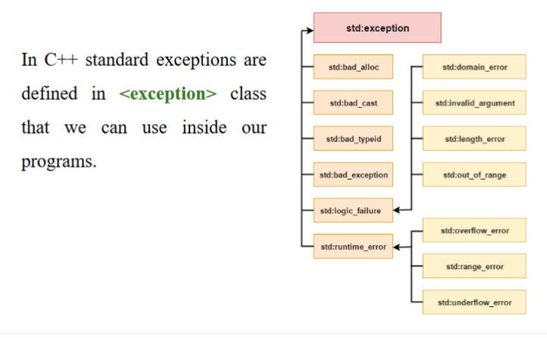
Exception class

Slide 32
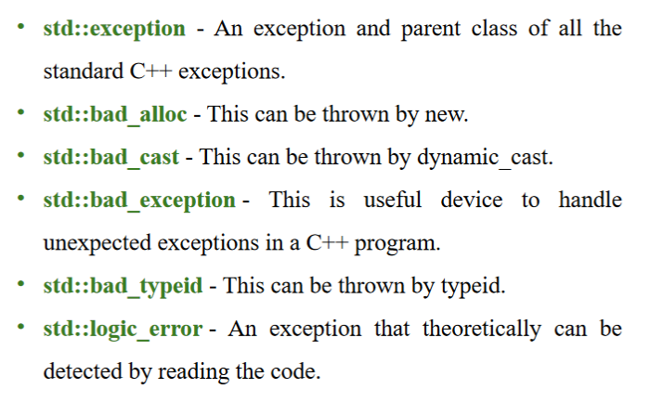

Slide 33
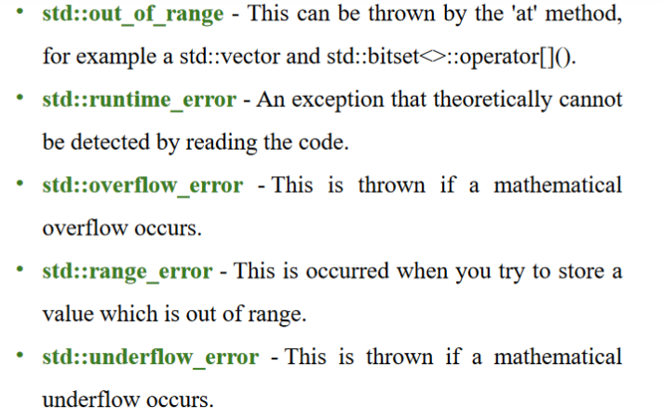
Type of exception

